Slide 1
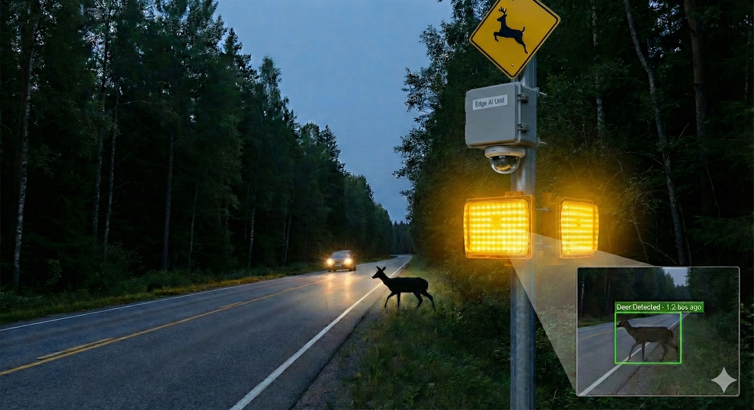
Edge-AI Wildlife Detection & Roadside Warning System
Enhancing Road Safety with Real-Time Computer Vision

Slide 2
The Problem
Wildlife-vehicle collisions are a major safety and conservation issue.
Static signs are often ignored by drivers.
Existing detection systems are expensive or slow.
The Need: An affordable, real-time, and autonomous warning system.

Slide 3
The Solution
Concept: A smart edge device that 'sees' wildlife and warns drivers instantly.
Core Function: Detects animals -> Triggers Flashing Beacon -> Logs Data.
Value Proposition: Low latency, privacy-preserving, and cost-effective.

Slide 4
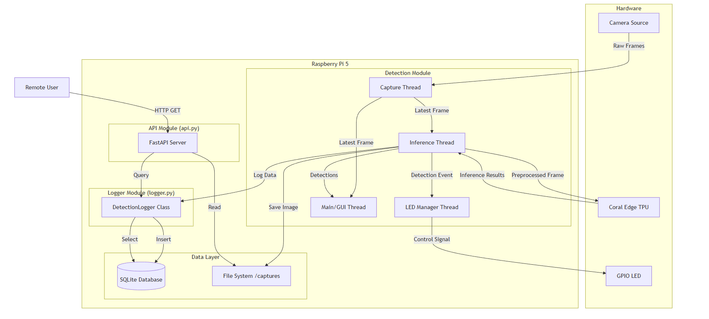
System Architecture
Input: Camera captures video.
Processing: Raspberry Pi 5 + Coral Edge TPU runs custom AI.
Action: Triggers LED Beacon immediately upon detection.
Data: Logs event to DB & exposes via API.

Slide 5
Technology Stack
Hardware: Raspberry Pi 5 (Speed) + Coral Edge TPU (AI Acceleration).
Custom AI: YOLO model trained specifically for local wildlife (Deer, Moose) in Google Colab.
Why Edge AI?: No internet needed for detection = Instant reaction time.

Slide 6
Live Demo / Prototype Showcase
Real-time bounding boxes on video feed.
Instant hardware response (LED Beacon).
API access for remote data monitoring.

Slide 7
Impact & Scalability
Road Safety: Reduces accidents with dynamic warnings.
Data Collection: Helps conservationists track animal crossings.
Scalability: Low cost allows for wide deployment.

Slide 8
Future Roadmap
Short Term: Night mode implementation & Web Dashboard.
Medium Term: Cloud synchronization.
Long Term: Integration with smart city infrastructure (V2X).

Slide 9
Conclusion
Summary: A working prototype solving a real-world problem with Edge AI.
Call to Action: 'Let's make our roads safer and smarter.'
Q&A

